Slide 1
Party A
Party B
Party A
Party B
Central counterparty
Party C
Party D
Party C
Party D

Slide 2
Day 1
Day 2
Day 3
Day 4
100 AAPL in account Sell AAPL @ $116.15
Buy F @ $12.59
Sell F @ $13.17
Funds from AAPL sale are received
922 shares in F
$7.02
$12,149.76
$11,615.00
freeriding
Day 1
Day 2
Day 3
Day 4
100 AAPL in account Sell AAPL @ $116.15
Buy F @ $12.59
No action
Funds from AAPL sale are received
Sell F @ $12.77
922 shares in F
$7.02
$11,780.96
$11,615.00

Slide 3
Alice’s account throughout the day
Clearing stage
£100
100 shares of A
£80 go out of Alice’s account
80 shares credited to her account
90 shares of A £10
80 shares of A £20

Slide 4
Blockchains | Best feature | Worst feature
 | Popularity | Poor performance
 | Security | Impractical
 | Performance | Poor security
 | Performance | Cost
 | Performance | Impractical

Slide 5
Regulator transaction{B, EX} transaction{A, B} transaction{B, C} transaction{A, EX}
Bank A transaction{A, B} transaction{A, EX}
Bank C transaction{B, C}
Bank B transaction{A, B} transaction{B, C} transaction{B, EX}
Exchange transaction{B, EX} transaction{A, EX}

Slide 6
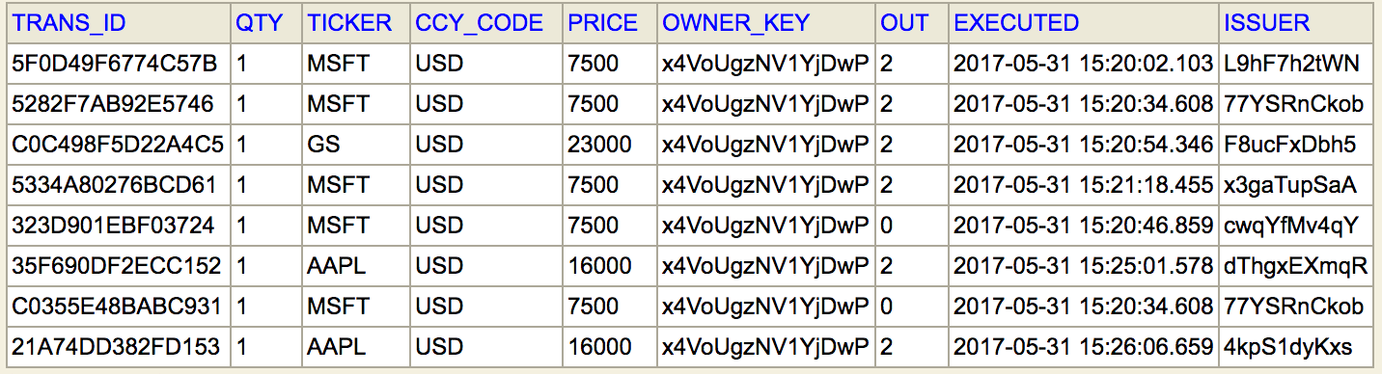
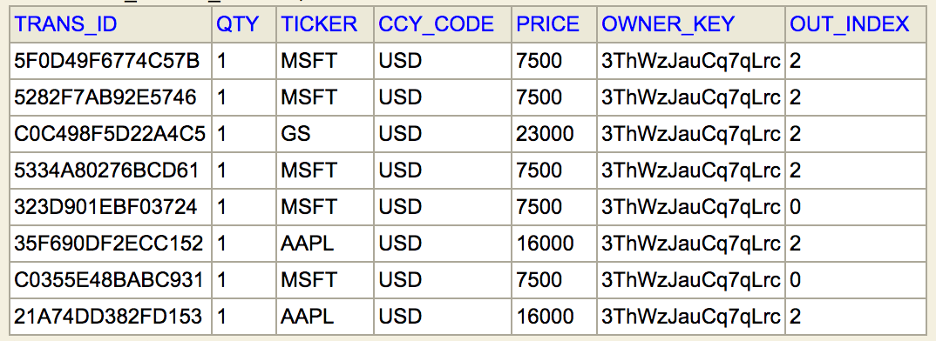
Share
trans_ID: String (PK) qty: Long
ticker: String currency: String
price: Long owner_key: String output_index: Int
execution_time: Instant issuer_key: String

Slide 7
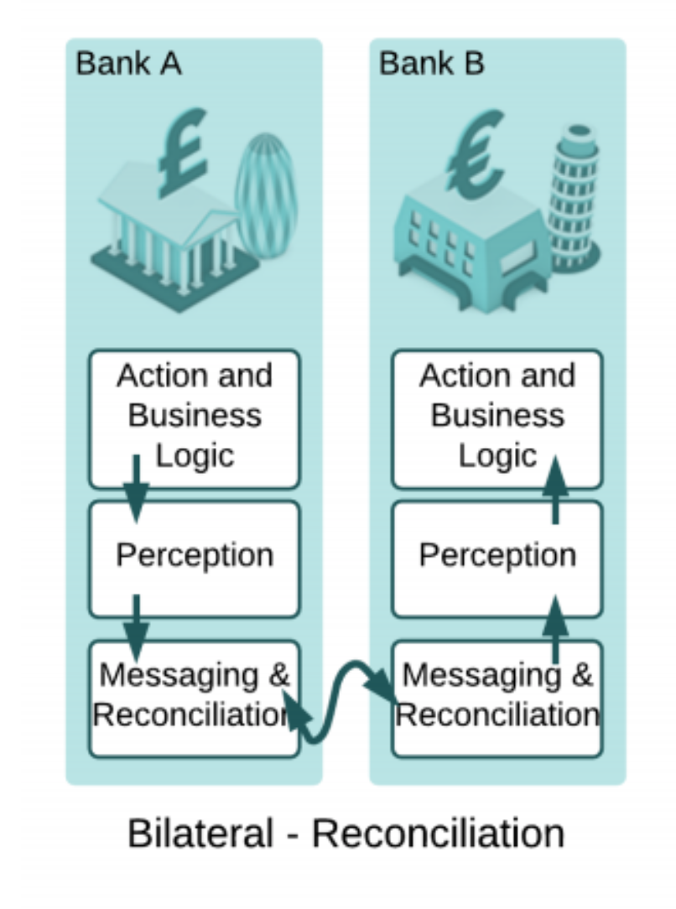
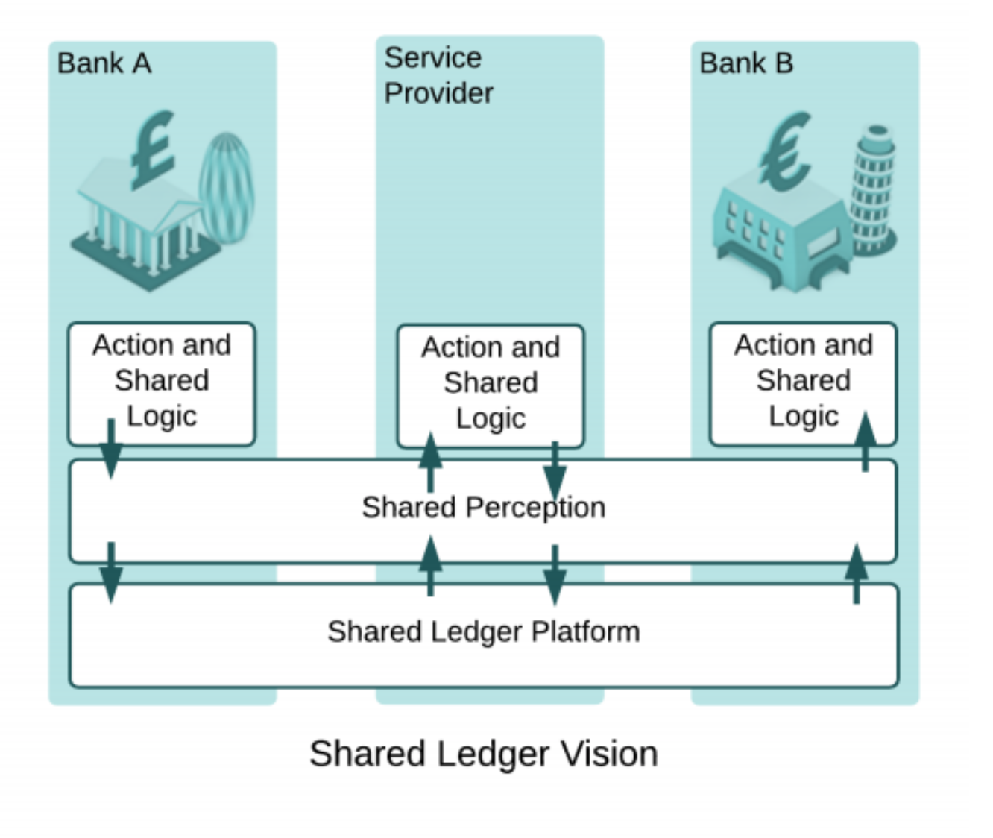

Slide 8
Bank A’s 💰💰💰
Bank A’s 💰💰💰
$600 (owned by Bank A)
$1000 (owned by Bank A)
$3500 (owned by Bank A)
$3500 (owned by Bank A)
Bank B’s 💰💰💰
$400 (owned by Bank B)
📄 (worth $400) owned by Bank B
📄 (worth $400) owned by Bank A

Slide 9
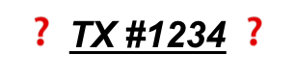
Bank A
Bank B (TX #1234)
TX #1234 ✅
Auditor
TX #1234 ✅
Bank D (TX #1234)
Bank C

Slide 10
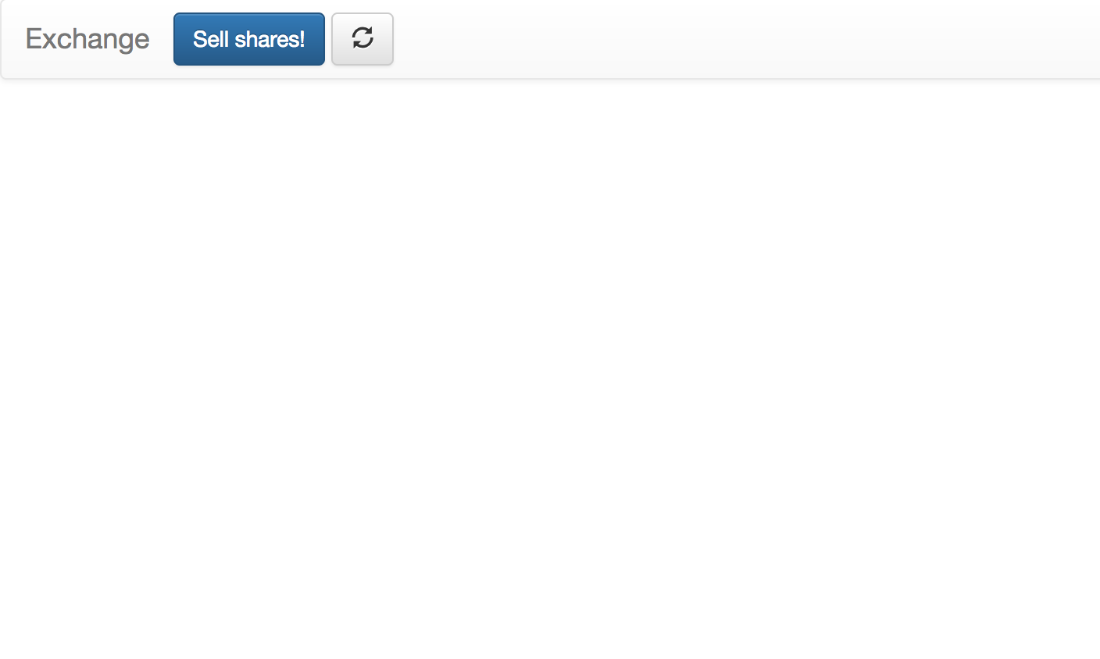
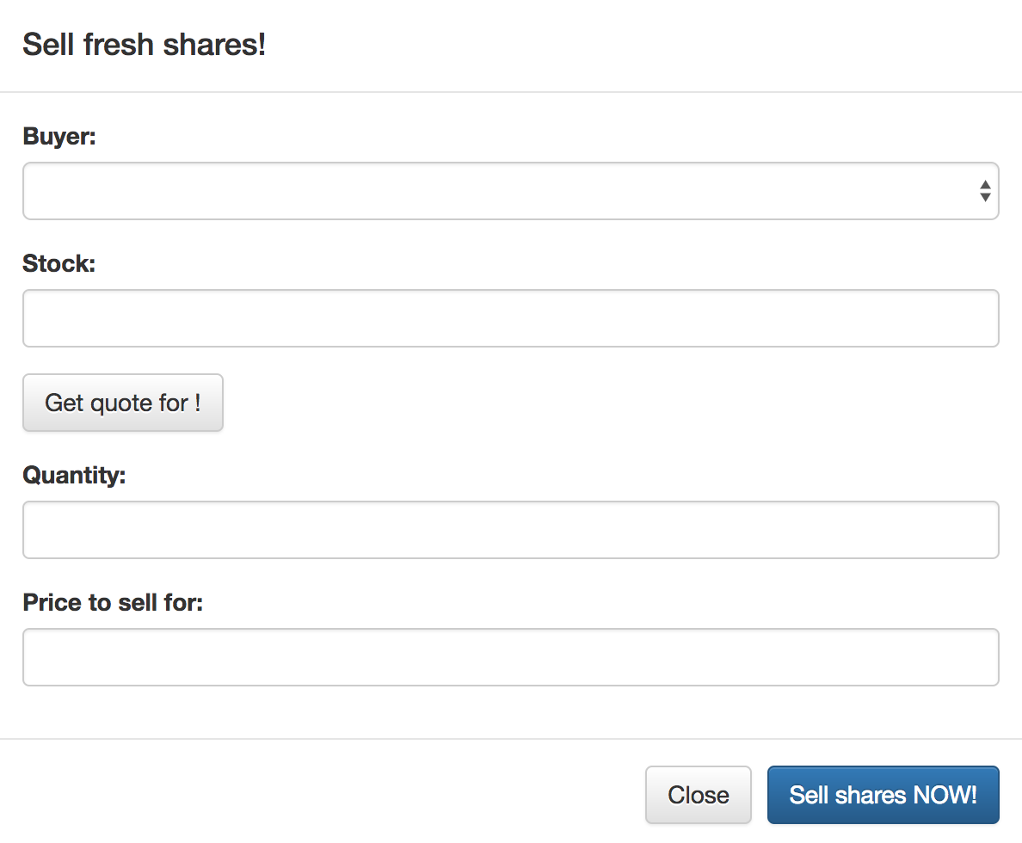

Slide 11
✅ Notary ✅
Bank A
💰
Hargreaves
📄💰
💰 Bank of Corda 💰
📄💰
Bank B
💰
Beaufort Securities
📄💰
📄
Bank C
💱 Exchange 💱
📄

Slide 12
Supernode A
Supernode B
Node A1
Node A2
Node A3
Node B1
Node B2
Node B3
Bank A
Bank A
Bank A
Bank B
Bank B
Bank B
Customer 1
Customer 2
Customer 3
Customer 4
Customer 5
Customer 6

Slide 13
Bank A
Bank B
Customer 1
Customer 2
Customer 3
Customer 4
Customer 5
Customer 6

Slide 14
Bank A
Bank B
Customer 1
Customer 2
Customer 3
Customer 4
Customer 5
Customer 6

Slide 15
Bank 1a
Bank Na
TX 1
TX N
Bank 1b
Bank Nb
We have n parallel transactions, happening between 2n nodes.

Slide 16
RAFT Cluster (many nodes)
Node Group A
Node Group B
Bank A
Bank B
Bank A
Bank A’s subsidiary
Bank B
Bank B

Slide 17
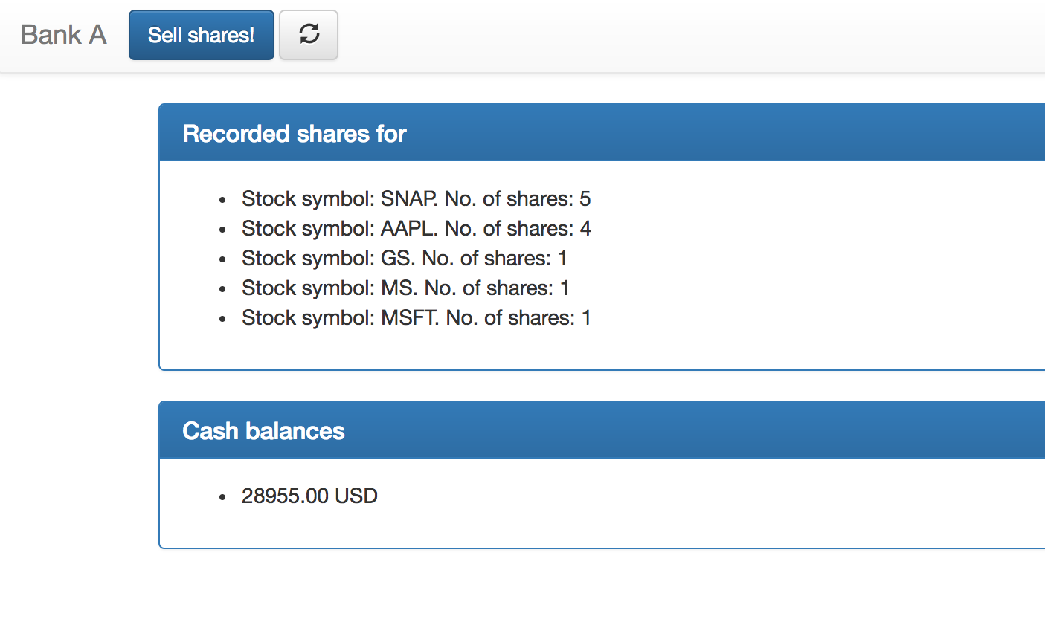

Slide 18
Notary services
Network map
Permissioning
TXs
storage
TLS certificates
AMPQ 1.0/TLS
Party A
Party B
Node A
Node A
CordApps
CordApps
vault
vault
TXs
TXs

Slide 19
💰 Bank of Corda 💰
issue cash 💵
self-issue shares 📄
Bank A
(Buyer)
Bank B (Seller)
Notary
external broker communication
Verifies contract constraints Signs with private key
Send proposed transaction for review
Receives and validates trade request Adds cash movement command Signs with private key
Send SignedTransaction to seller for review
Receives and checks proposed transaction (signatures + contract constraints) Adds signature to SignedTransaction
Request signature by notary
Sign transaction
Receive final transaction
Receive final transaction
Record transaction
Broadcast transaction to participants
Record transaction

Slide 20
💰 Central Bank 💰
issue cash 💵
Bank A
(Buyer)
cash vs. assets exchange
Bank B (Seller)
💵 vs. 📄 exchange
Exchange “offers” (sells) shares to public investors (who have accounts in the shown banks)
📄 Exchange 📄
Company 1
IPOs shares are centralized on the exchange 📄
Company 2
Company 3

Slide 21
Requirement type | Required standard | Existent implementation
Performance | 100K TPS | Theoretically unlimited TPS, 80K+ TPS for notarisation (with growing potential) => ✅
Security and privacy | Hiding information, IP obfuscation, private network | Data sharing on a need-to-know basis, notaries do not have access to transaction details, private network with obfuscated IPs throughout transactions => ✅
Scalability | Incorporate new nodes seamlessly | On-the-fly node addition with no added latency => ✅
Reliability | Extremely reliable due to its criticality | Node failure management, database persistence, node-level backups => ✅
Usability and costs | Intuitive system, reasonable costs | Intuitive web interface, system has the potential to save billions every year => ✅
Compliance | MiFID II compliant, KYC, AML, ATF controls, auditing facilities | In the final system, all will be implemented accordingly – even now, it is MiFID II compliant and has limited auditing facilities => ✅

